Slide 1
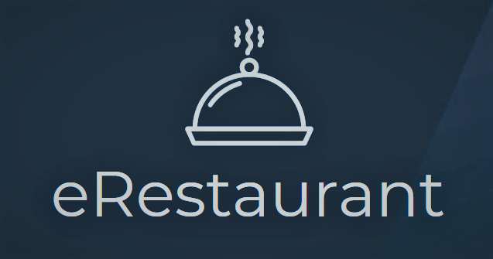
Restaurant Manager Web Application
SUPERVISOR:
TEAM MEMBERS:
MR. TRAN DINH TRI
SE04295 AU VAN THINH
SE03990 DUONG TUAN NHAT
SE04319 NGUYEN MINH HIEU
SE04066 NGUYEN ANH DUNG
SE04270 NGUYEN CHI NGHIA

Slide 2

PRESENTATION OUTLINE
1. Project overview
3. Software specification
4. Software design
6. Project result
7. Demo
2. Project management
5. Testing

Slide 3

Problem
Solution
Idea
PROJECT
OVERVIEW

Slide 4






PROJECT OVERVIEW - Problem
In The Fourth Industrial Revolution, an application which helps people manage their business easily and effective is very popular and must-have.
Customer
Chef
eRestaurant
Manager
Cashier

Slide 5


PROJECT OVERVIEW - Problem
So, we will build a Web Based Application for Restaurant Management which have many different functions to helps restaurant manager and customer for:
Saving time for customer in pre-order.
Saving time in order phase.
Saving time and money in statistics.
Improving waiter to chef interaction.
Improving revenues of restaurant.

Slide 6

PROJECT OVERVIEW - Idea
Functional:
Manage Order Workflow
Manage Staff, Table, Food…
Recommend Food For Customer
Statistic

Slide 7
PROJECT OVERVIEW - Idea
Non-Functional:
The application's UI should be simple, friendly, logical and easy to use.
Multiple devices can use at the same time
Authenticate Requirement for web service
Manage multimedia data
Notes:
Dua tren viec phan tich cac van de thuan Nguyen, nhom phat trien phan mem dap ung duoc cac yeu cau
Cac yeu cau chuc nang va phi chuc nang (khai quat quan ly)

Slide 8
PROJECT OVERVIEW - Solution
To reach our above goals, we will develop a Web Based Application with MVVM Model and many functions which support these goals:
Pre-order System
Real time Order System
Dishes Suggesting System
Statistics System

Slide 9

Project Model
Organization Structure
Master Schedule
Objects
Tools & Environment
Project Life cycle
Communication plan
PROJECT
MANAGEMENT

Slide 10

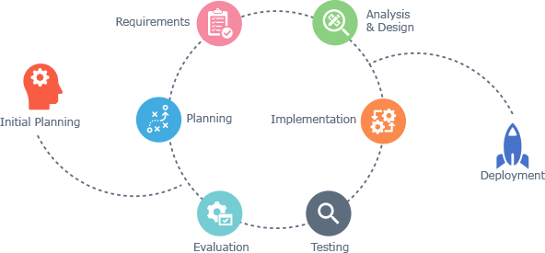
PROJECT MANAGEMENT – Project Model
Iterative & Incremental software process model

Slide 11

PROJECT MANAGEMENT – Project Model
Why choose Iterative & Incremental software process model ?
This model is more flexible – less costly to change scope and requirements.
Reduce the risk of delay due to the important work done first.
Through every iterative, we can control scope and requirements, flexibly update

Slide 12
PROJECT MANAGEMENT – Project Model
Why choose Iterative & Incremental software process model ?
Project team will always communicate with users to obtain information to meet the needs of users
It is easy to manage risk by dividing it into pieces and solve it as quick as possible in each iterative.

Slide 13
PROJECT MANAGEMENT – Project Life Cycle
Iteration #1
1. Planning and Collect Requirement
2. Create Architecture Overview
3. Create ERD Diagram
4. Design Database
5. Training and development
6. Testing and fix bug

Slide 14
PROJECT MANAGEMENT – Project Life Cycle
Iteration #2
1. Collect feedback from demo product
2. Update project management plan
3. Update System Design
4. Complete coding and test
5. Deploy website
6. Complete user manual
7. Complete all reports and documents

Slide 15
PROJECT MANAGEMENT – Organization Structure
Supervisor
Tran Dinh Tri
Project Manager
Au Van Thinh
Documentation Subteam Leader
Nguyen Chi Nghia
Analysis &Desgin Subteam Leader
Duong Tuan Nhat
Coding Subteam Leader
Nguyen Anh Dung
Testing Subteam Leader
Duong Tuan Nhat
Team Member
Au Van Thinh
Team Member
Duong Tuan Nhat
Team Member
Nguyen Anh Dung
Team Member
Nguyen Minh Hieu
Team Member
Nguyen Anh Dung
Team Member
Nguyen Minh Hieu
Team Member
Au Van Thinh
Team Member
Duong Tuan Nhat
Team Member
Nguyen Minh Hieu
Team Member
Au Van Thinh
Team Member
Nguyen Chi Nghia

Slide 16
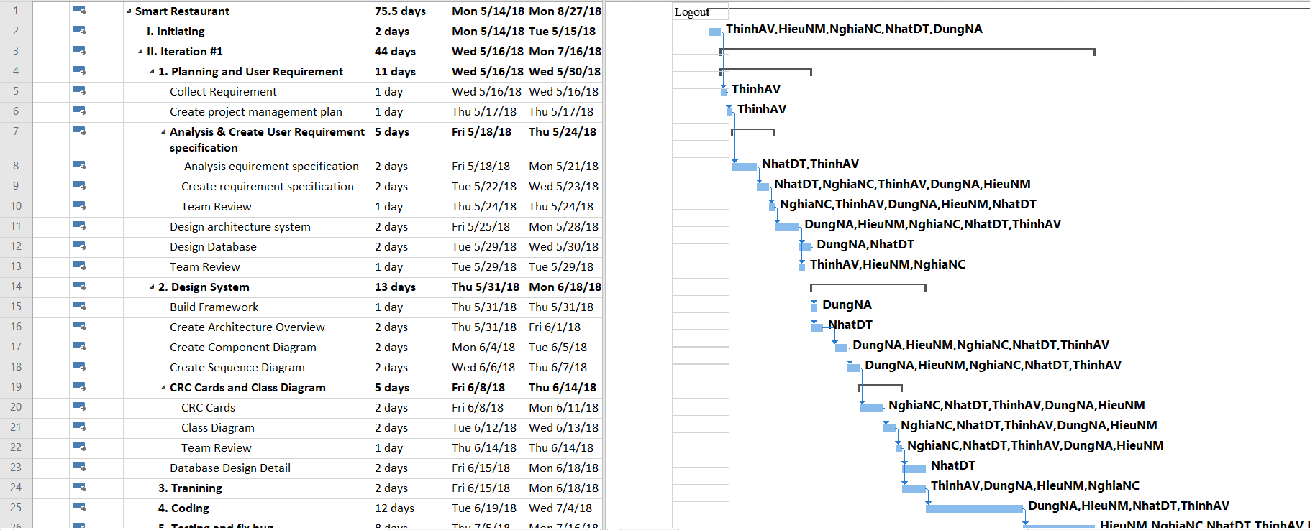
PROJECT MANAGEMENT – Master Schedule

Slide 17
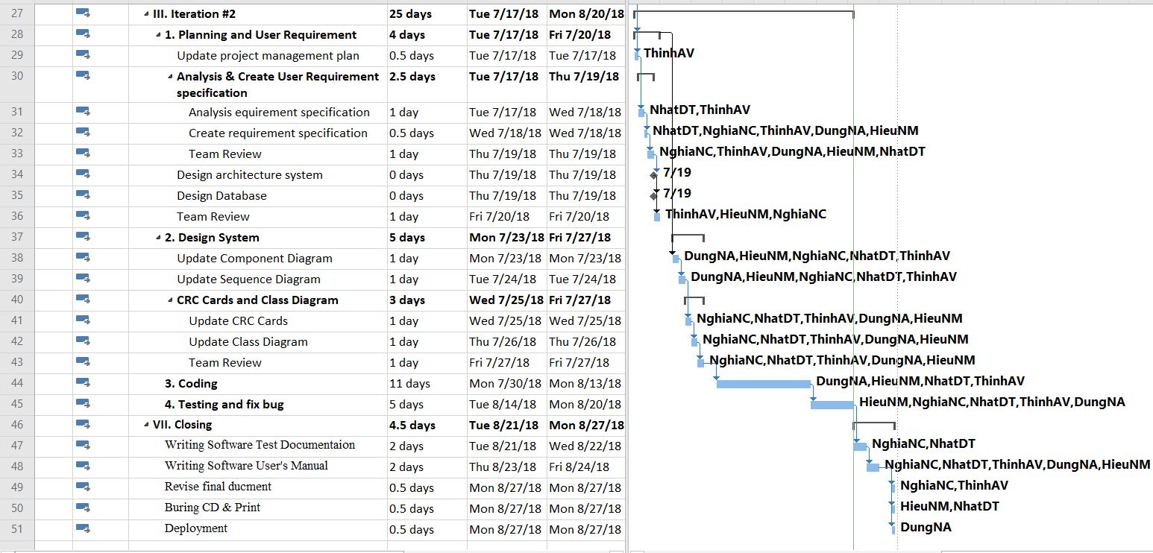
PROJECT MANAGEMENT – Master Schedule

Slide 18
PROJECT MANAGEMENT – Communication plan
Meeting with team members | 2 times per week, meeting will be held at 9: am on Tuesday and Friday
Meeting with supervisor | 1 time per week, at 4: pm on Tuesday
Special meeting | When there are anomalous issues which need to solve immediately

Slide 19
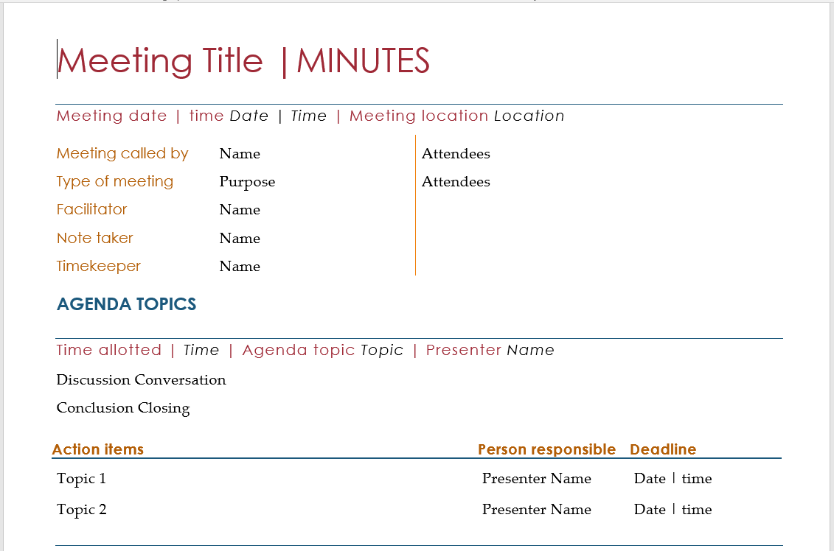
PROJECT MANAGEMENT – Communication plan
Meeting Minute template

Slide 20
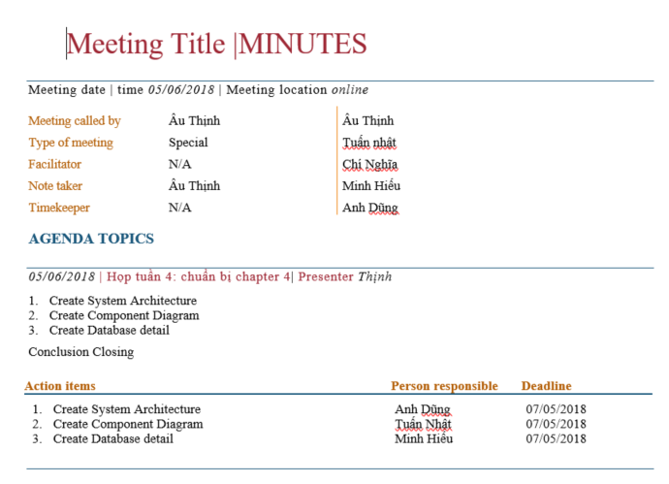
PROJECT MANAGEMENT – Communication plan
Meeting Minute template

Slide 21
PROJECT MANAGEMENT – Objects
Metrics | Unit | Committed | Actual | Deviation
Start Date | dd-mm-yyyy | 14-05-2018 | 14-05-2018 | 0 days
End Date | dd-mm-yyyy | 27-8-2018 | 28-8-2018 | 1 days
Duration | Elapsed days | 76 days | 77 days | 1 days
Maximum Team Size | Person | 5 | 5 | 0

Slide 22







PROJECT MANAGEMENT – Tools & Environments

Slide 23

System Overview
System Use Case
Definitions
SOFTWARE
SPECIFICATION

Slide 24

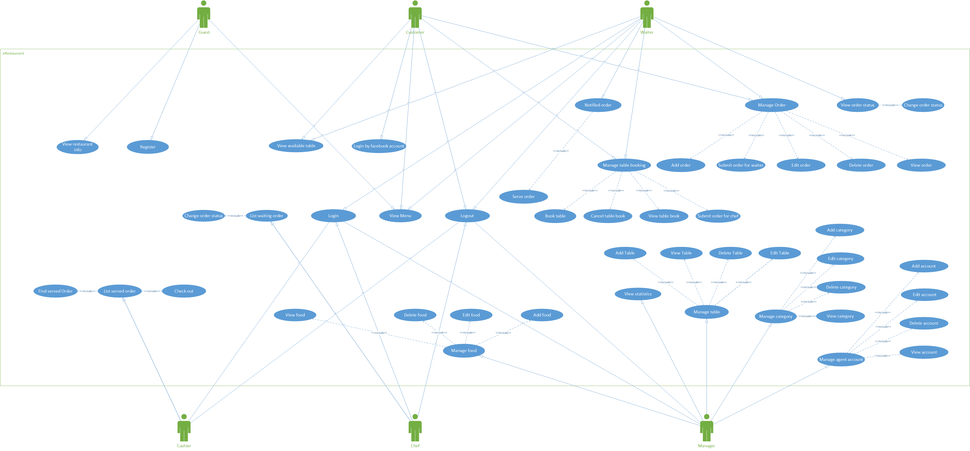
SOFTWARE SPECIFICATION – System Overview
Notes:
Staff thanh LFMS user

Slide 25
SOFTWARE SPECIFICATION – Definitions
User groups | Definitions
Guest | who has not had account in system yet
Customer | who already had an account in system
Waiter | who helps customer make order and booking
Chef | who pick dish from order list to cook
Cashier | who has responsibility to help customer check out
Manager | who can manage business process and view reports
Notes:
Staff thanh LFMS user

Slide 26
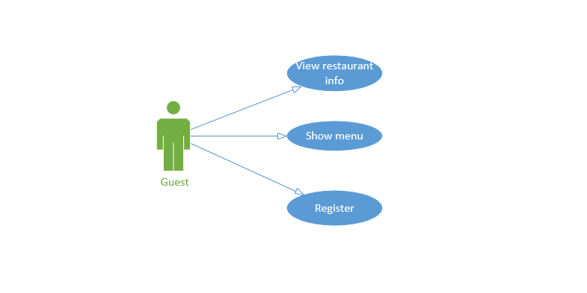
SOFTWARE SPECIFICATION –System Use Case
Guest

Slide 27
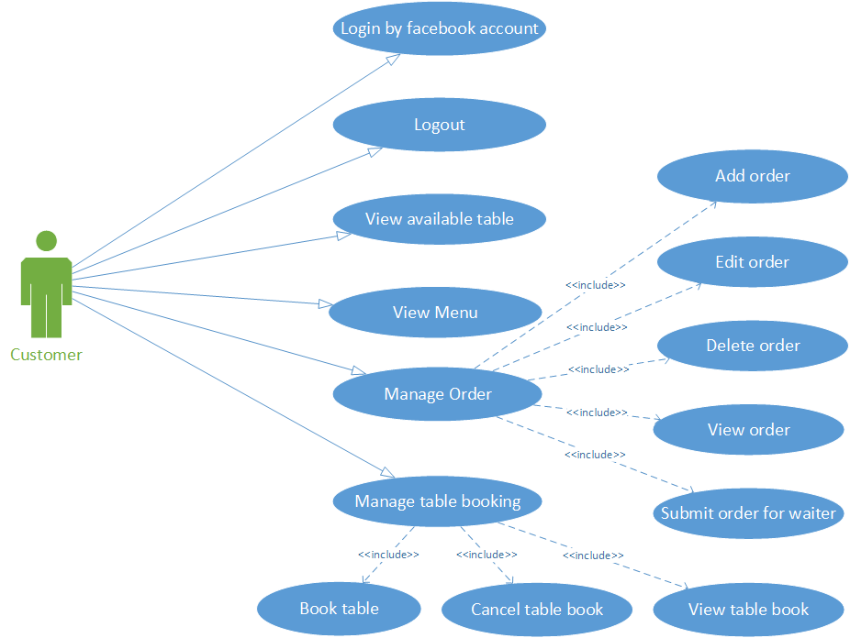
SOFTWARE SPECIFICATION –System Use Case
Customer

Slide 28
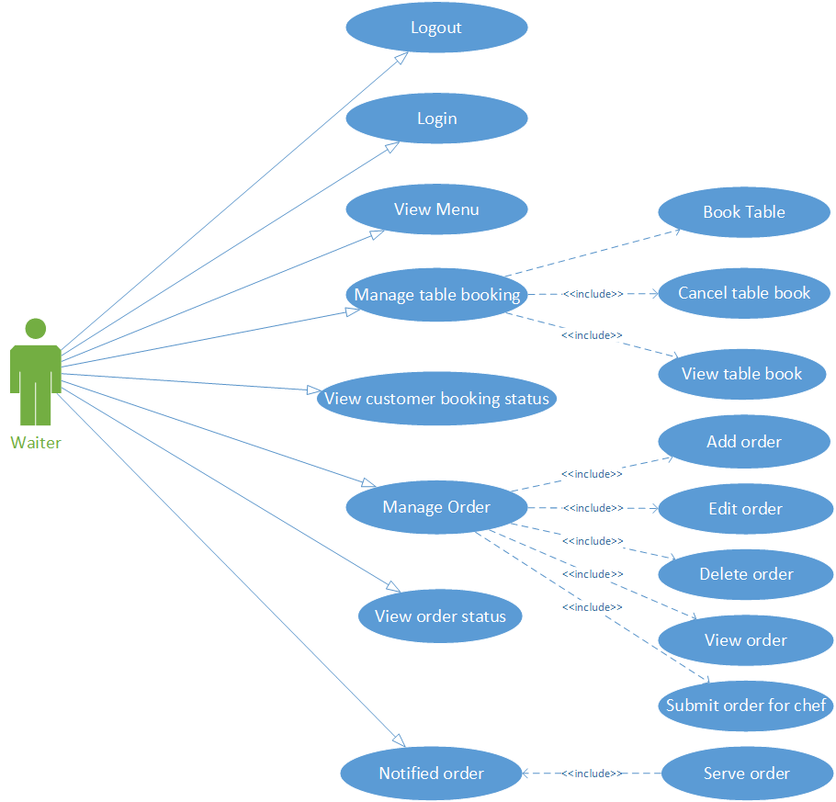
SOFTWARE SPECIFICATION –System Use Case
Waiter

Slide 29
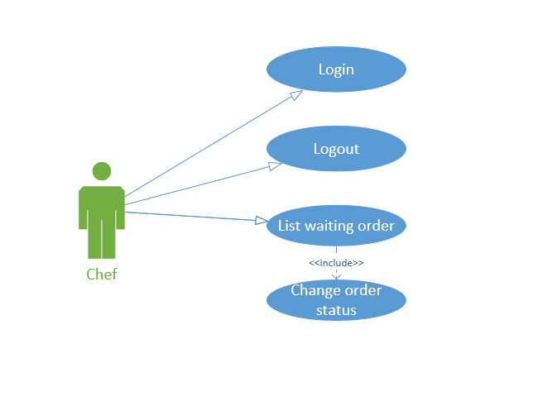
SOFTWARE SPECIFICATION –System Use Case
Chef

Slide 30
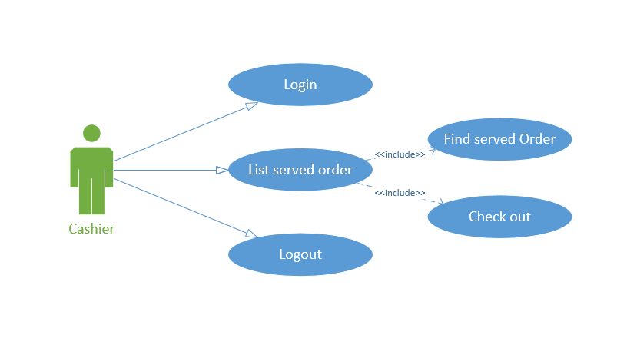
SOFTWARE SPECIFICATION –System Use Case
Cashier

Slide 31
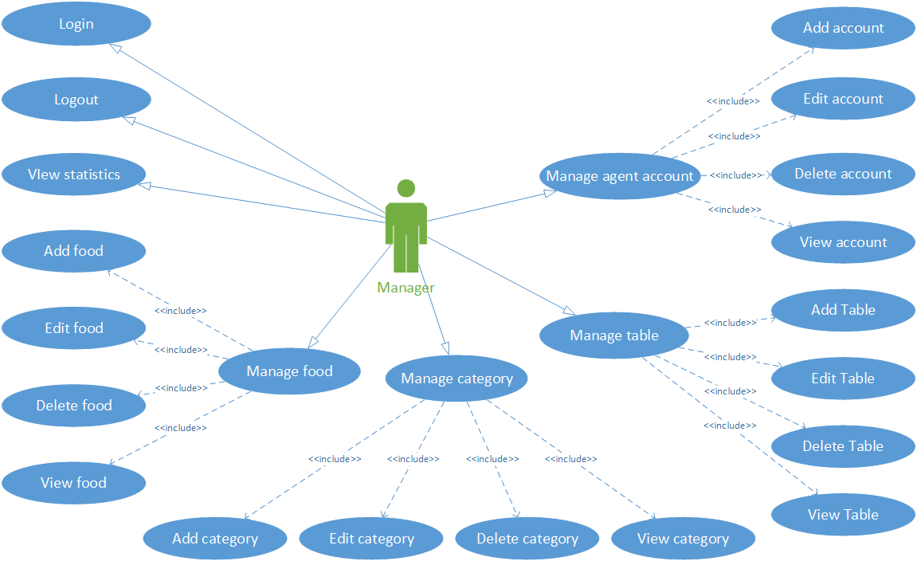
SOFTWARE SPECIFICATION –System Use Case
Manager

Slide 32

Architecture Overview
Entity Relationship
Database Design
Component Diagram
Sequence Diagram
Recommend Algorithm
SOFTWARE
DESIGN

Slide 33

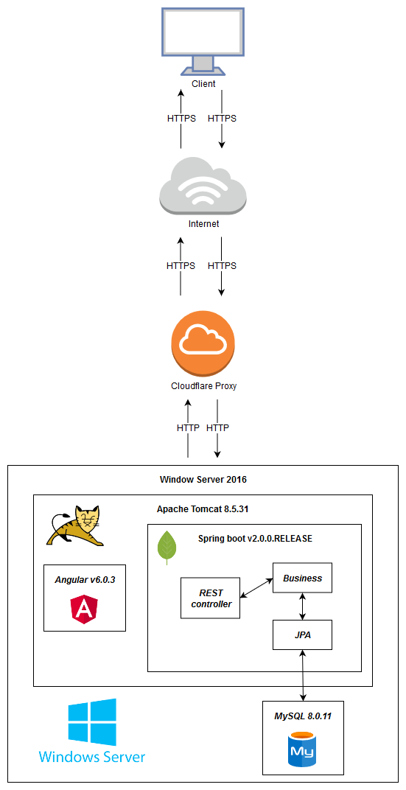
SOFTWARE DESIGN – Architecture Overview
Cloudflare Proxy
Window Server 2016
Apache Tomcat
MySQL
Spring boot
Angular

Slide 34
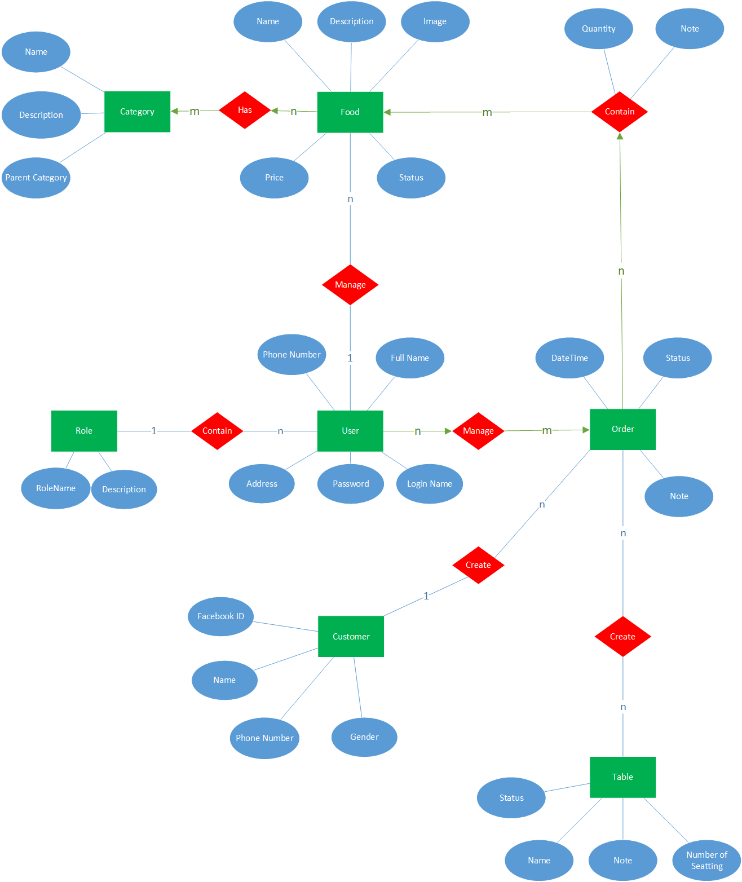
SOFTWARE DESIGN – Entity Relationship

Slide 35
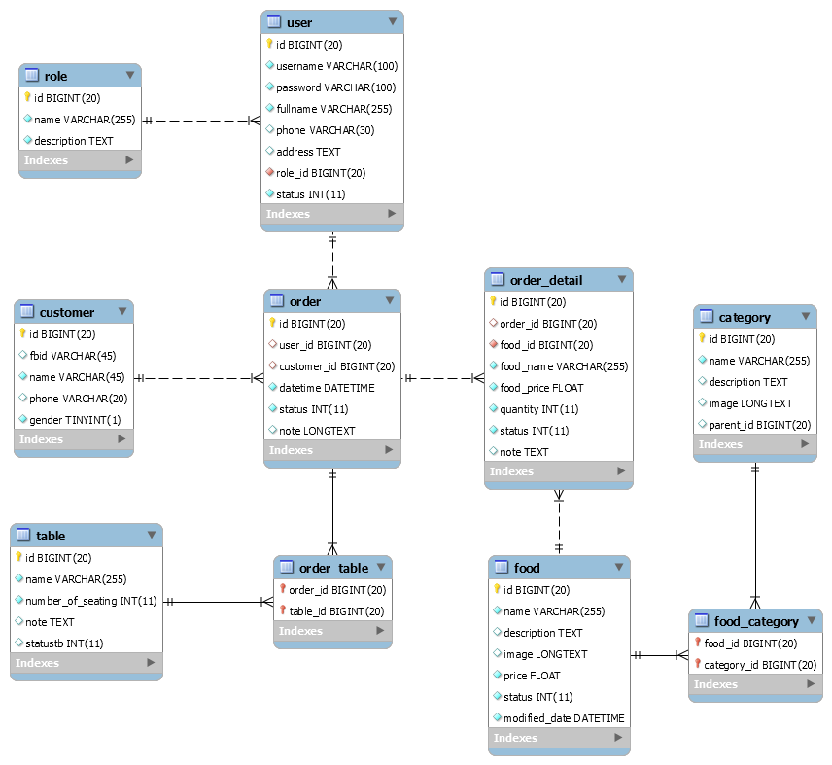
SOFTWARE DESIGN – Database Design

Slide 36
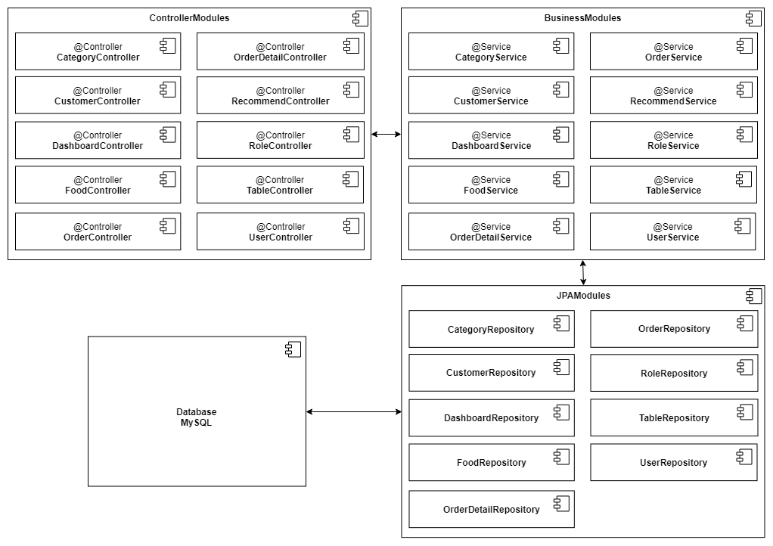
SOFTWARE DESIGN – Component Diagram

Slide 37
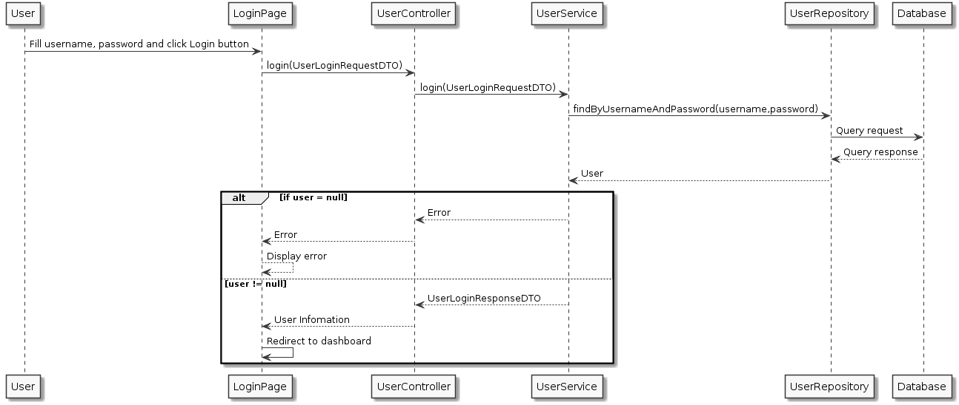
SOFTWARE DESIGN – Sequence Diagram
Login for user

Slide 38
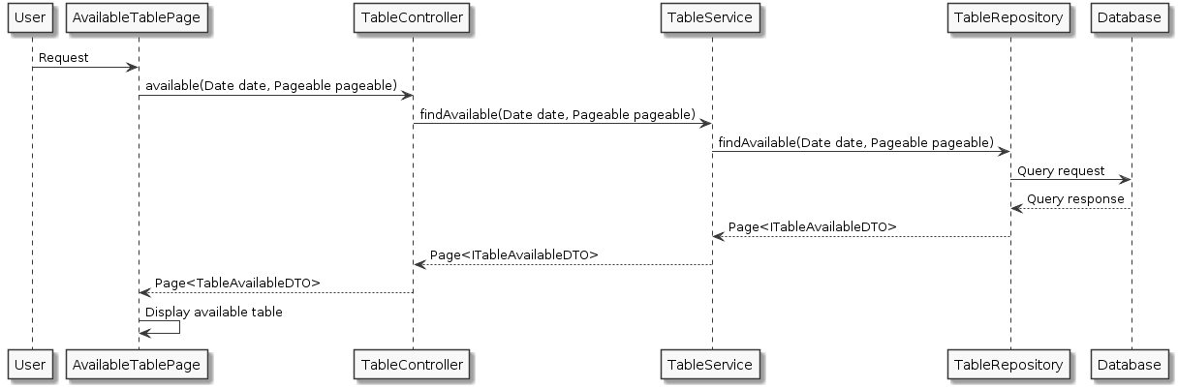
SOFTWARE DESIGN – Sequence Diagram
Show Available Table

Slide 39
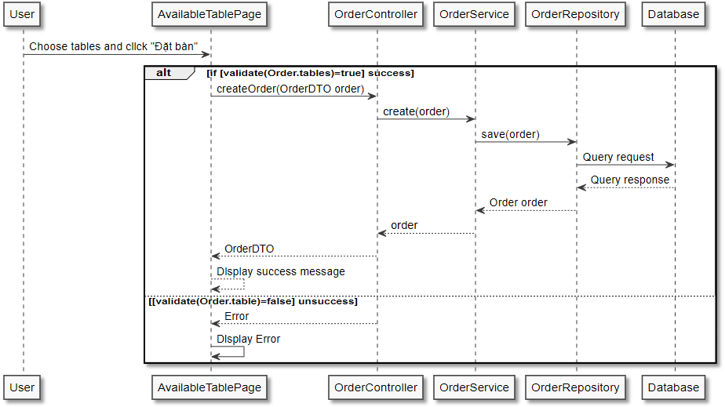
SOFTWARE DESIGN – Sequence Diagram
Create Table Booking

Slide 40
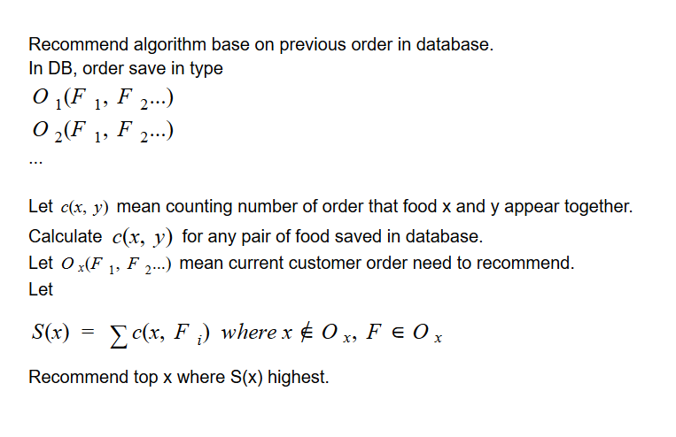
SOFTWARE DESIGN – Algorithm

Slide 41
SOFTWARE DESIGN – Algorithm
Order | Food |  | c(x, y) | F1 | F2 | F3 | F4 | F5
O1 | F1, F2, F3 |  | F1 |  | 2 | 4 | 1 | 1
O2 | F1, F2, F3 |  | F2 | 2 |  | 2 | 0 | 0
O3 | F1, F3, F5 |  | F3 | 4 | 2 |  | 2 | 2
O4 | F3, F4, F5 |  | F4 | 1 | 0 | 2 |  | 1
O5 | F1, F3, F4 |  | F5 | 1 | 0 | 2 | 1
Order | Food |  | x | S(x)
Ox | F1, F3 |  | F2 | 4
 |  |  | F4 | 3
 |  |  | F5 | 3

Slide 42

Test Model
Test Process
Test Result
Defect Log
TESTING

Slide 43

TESTING – Test Model
Customer requirement
validate
Acceptance test
Product specifications
verify/validate
System test
High-level design
verify
Integration test
other V&V activities
Low-level design
verify
Unit test
Coding & unit test

Slide 44
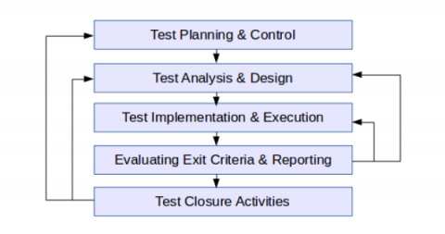
TESTING – Test Process

Slide 45
TESTING – Test Schedule
Test Schedule | Start Date | End Date
Iteration 1: Main features | 18/06/2018 | 15/07/2018
Unit Testing | 18/06/2018 | 05/07/2018
Functional Testing | 05/07/2018 | 15/07/2018
Iteration 2: Other features | 31/07/2018 | 18/08/2018
Unit Testing | 31/07/2018 | 10/08/2018
Functional Testing | 10/08/2018 | 15/08/2018
Acceptance testing | 15/08/2018 | 18/08/2018

Slide 46
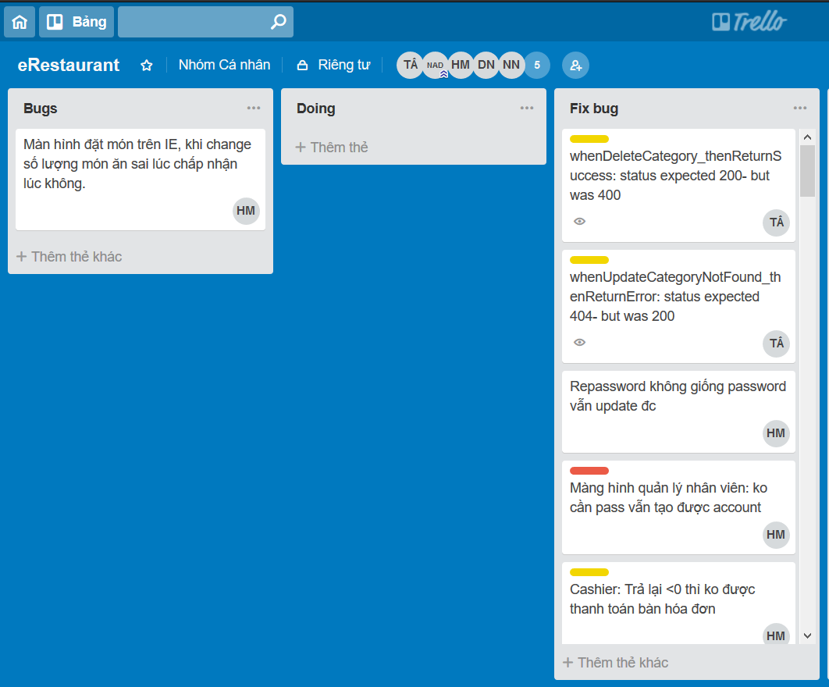
TESTING – Defect Log

Slide 47
TESTING – Bug list report
Bug ID | TestCase | Log Date | Description | Owner | Assignee | Status | Retest date
25 | TC.24.01 | 8/14/2018 | Manage Table: danh sách bàn ko hiển thị | Au Thinh | Minh Hieu | Done | 8/15/2018
26 | TC.21.04 | 8/14/2018 | realtime: ko pick món nào rồi ấn submit (manager order) vẫn hiện thông báo có món cần nấu ở màn hình chef | Au Thinh | Minh Hieu Anh Dung | Done | 8/14/2018
27 | TC.13.01 | 8/14/2018 | Manage Agent Account: không lưu đc nhân viên khi tạo mới hoặc sửa | Au Thinh | Anh Dung | Done | 8/14/2018
28 | TC.22.04 | 8/14/2018 | Realtime: màn hình cashier, manager booking: khi checkout 1 order màn hình manager booking không reload status | Au Thinh | Anh Dung | Done | 8/14/2018
29 | TC.22.04 | 8/14/2018 | Realtime: màn hình cashier, manager booking: khi hủy một order (manager book), màn hình cashier ko reload | Au Thinh | Anh Dung | Done | 8/14/2018
30 | TC.24.01 | 8/16/2018 | fix available table (khong hien thi table vs status = 2) | Au Thinh | Minh Hieu | Done | 8/17/2018
31 | TC.20.07 | 8/16/2018 | fix bug không tương thich event ở các browser khác nhau | Au Thinh | Minh Hieu | Done | 8/17/2018
32 | TC.13.03 | 8/20/2018 | Repassword không giống password vẫn update đc | Duong Nhat | Minh Hieu Anh Dung | Done | 8/22/2018
33 | TC.13.03 | 8/21/2018 | Màng hình quản lý nhân viên: ko cần pass vẫn tạo được account | Duong Nhat | Minh Hieu | Done | 8/23/2018

Slide 48
TESTING – Test Result
No | Module Code | Pass | Fail | Untested | N/A | Number of testcase
1 | Admin | 40 | 0 | 0 | 0 | 40
2 | Guest | 4 | 0 | 0 | 0 | 4
3 | Customer | 24 | 0 | 0 | 0 | 24
4 | Chef | 4 | 0 | 0 | 0 | 4
5 | Cashier | 8 | 0 | 0 | 0 | 8
6 | Waiter | 26 | 0 | 0 | 0 | 26
7 | Authen | 25 | 0 | 0 | 0 | 25
 | Total | 131 | 0 | 0 | 0 | 131
Test Coverage | 100.00%
Test Success Coverage | 100.00%

Slide 49

Project result
Comparison Result
Lesson Learned
PROJECT
RESULT

Slide 50

PROJECT RESULT – Test Result
After closing project, we achieve goal software:
Customer can book table and order every time and every where
Staff can work more effective, easier and simpler way with synchronous system between positions
Manager firm can manage all information like staff, table, food, category
Accounting easier with statistical in every days, month and year.

Slide 51
PROJECT RESULT – Limitation & Expectation
Limitation:
Only supports some popular browsers: Chrome, Firefox, Safari
Only support Vietnamese Language
Can not backup data
Depends on the network connection
Expectation:
Develop more in other browser
Develop multilingual Language
Develop client with mobile version like android, ios

Slide 52
PROJECT RESULT – Lesson Learned
Situation | Problem | Lessons learned
Conflict in team | Members are stress Cannot make decision | Talk and listen to each other Analysis situation Make right decisions
Technical difficulties | Take lots of time to solve Miss the deadline | Search in Google or some IT forums Ask group’s supervisor or teachers for some advices

Slide 53

DEMO
Homepage
Manage Staff, Table, Food, Category
Workflow in synchronous system between positions

Slide 54


Slide 55
Thanks for watching

